Slide 1
Safety Monitoring System for Dementia Patient Using Smart Watch
Team 15 – IoT for Disabilities Assistance
Chaeyeon Song, Dongjin Shin, Namhyo Kim, Nathan Gronowski, Nayun Kim, Seokjoo Cho, Bohyun Kim
Presenter: Namhyo Kim, Dongjin Shin
Notes:
I’m Chaeyeon Song, this is team 15 about smartwatch application for dementia patients.
I’m taking on presentation for last goals and flow of smart watch application & server.
Next, Nayun Kim will present flow of smart phone application and goals.
=> 추후에 작성, 제목변경

Slide 2
Contents
Problem statement
Project goal
Implementation
Limitations / Improvements
Expected effects

Slide 3
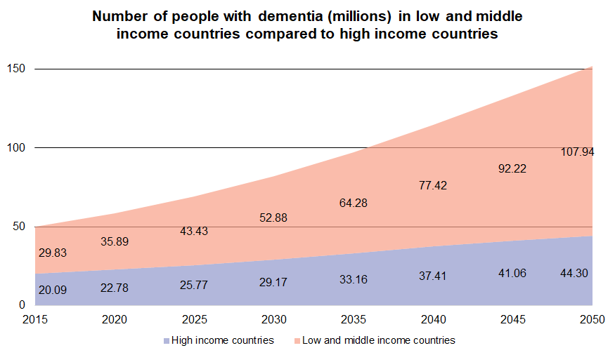
Problem statement
Increase in Dementia patients
Over 47 million people have dementia globally
This number is expected to nearly triple by 2050
Due to the increase in average life expectancy, the rate of dementia is increasing
Alzheimer’s Assoc., “2018 Alzheimer’s disease facts and figures.” vol. 14, no. 3, pp. 367-429, Mar. 2018, [Online]. Available: https://alz-journals.onlinelibrary.wiley.com/doi/abs/10.1016/j.jalz.2018.02.001.
Graph from Alzheimer’s Disease International

Slide 4
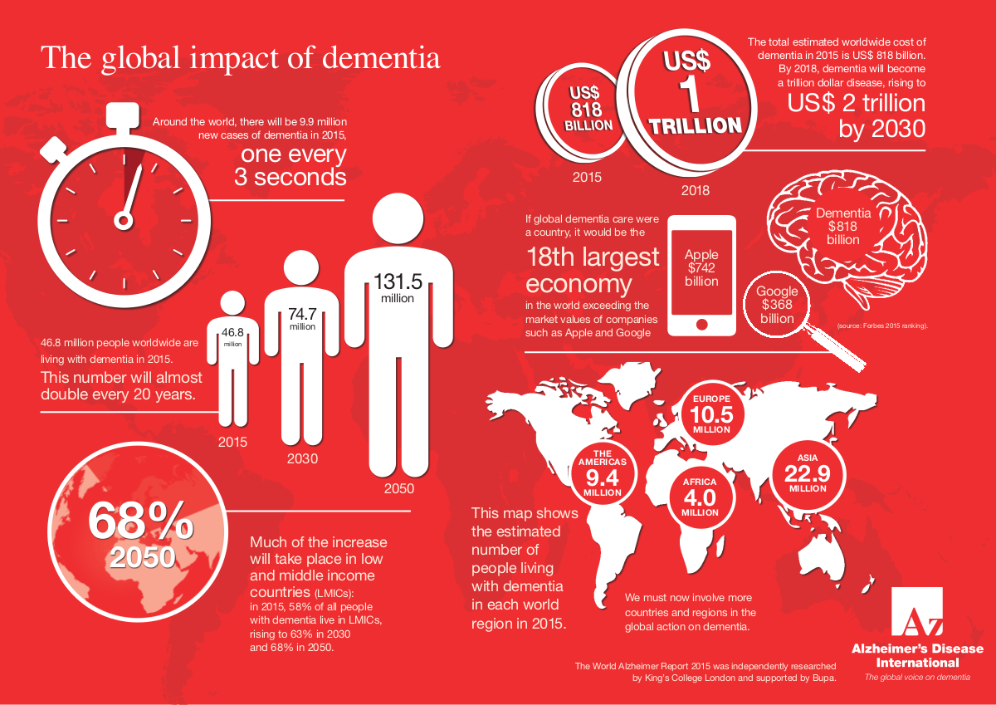
Problem statement
Increase of Dementia patients

Slide 5
Project goal
Our project aims to prevent dementia patient from getting lost
Smartphone application tracks the patient so that guardians know where the patient is
Smart watch shows current address to patient and sends location data to server
Smartphone app notifies guardian if patient gets out of boundary
Smartphone app sends message to patient if he/she gets out of boundary
Smart watch runs navigation to home if patient gets out of range

Slide 6
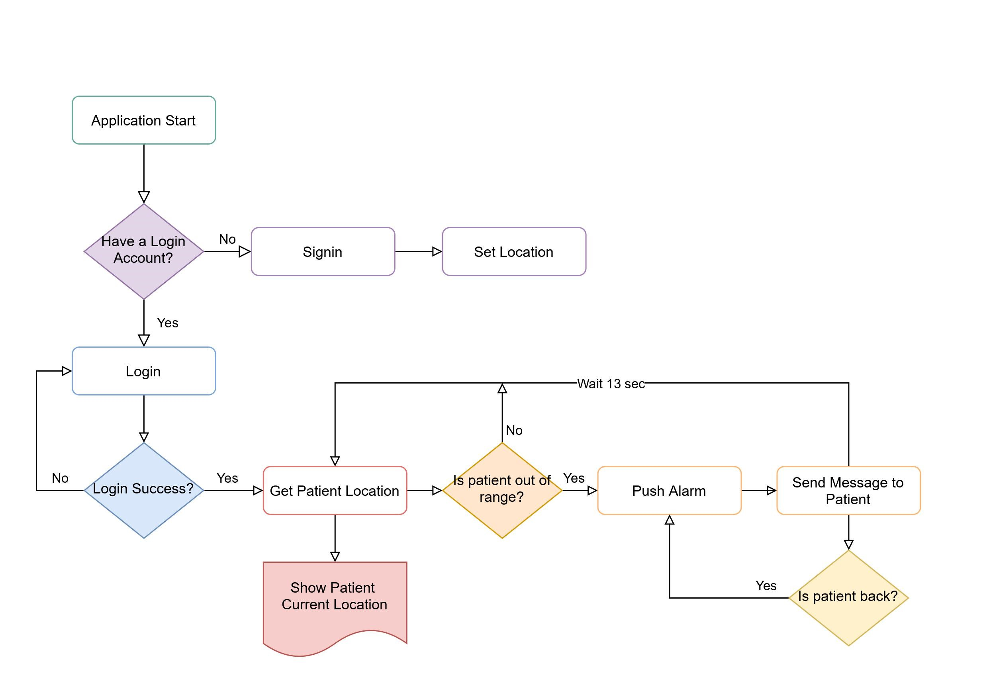
Flow chart (Smart Phone)
Notes:
The last goals were
Creating the connection between the applications and the server
Setting up queries for the applications so that data can be stored
Start building GUI for smart phone application

Slide 7
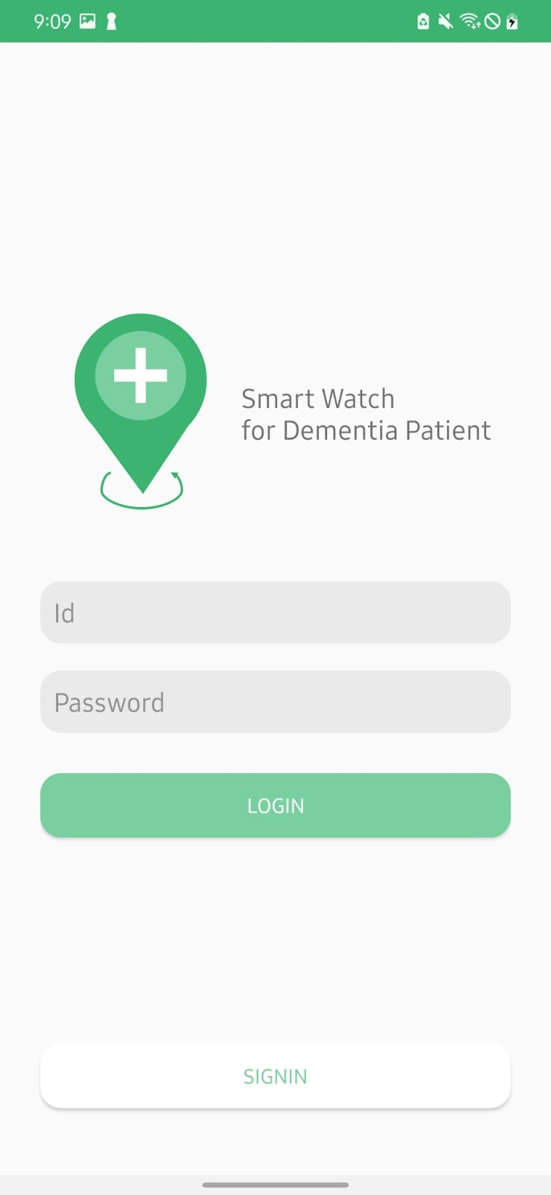
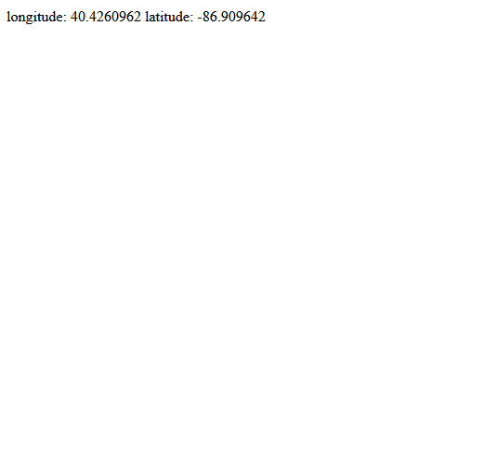
Flow of Application Development
Smartphone Application (Login)
Login Page was created
User can input id and password
When the user enters the right login information, app shows the success message and go to Main page
On the other hand, if incorrect information is entered, app shows the fail message
Notes:
Last week: Basic outline of application has been created

Slide 8
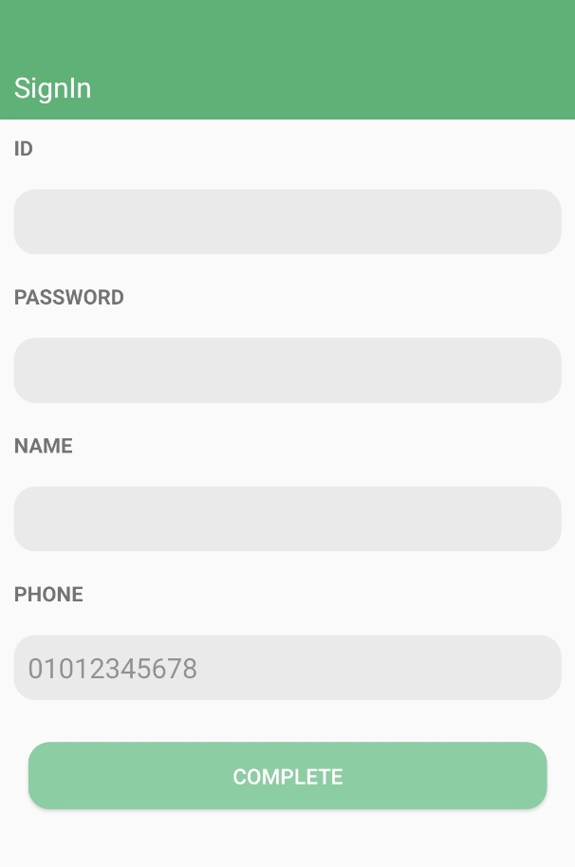
Flow of Application Development
Smartphone Application (SignIn-user information)
SignIn Page has been created
All these items must be entered
When complete button is clicked, go to Location Register Page
Notes:
Last week: Basic outline of application has been created

Slide 9
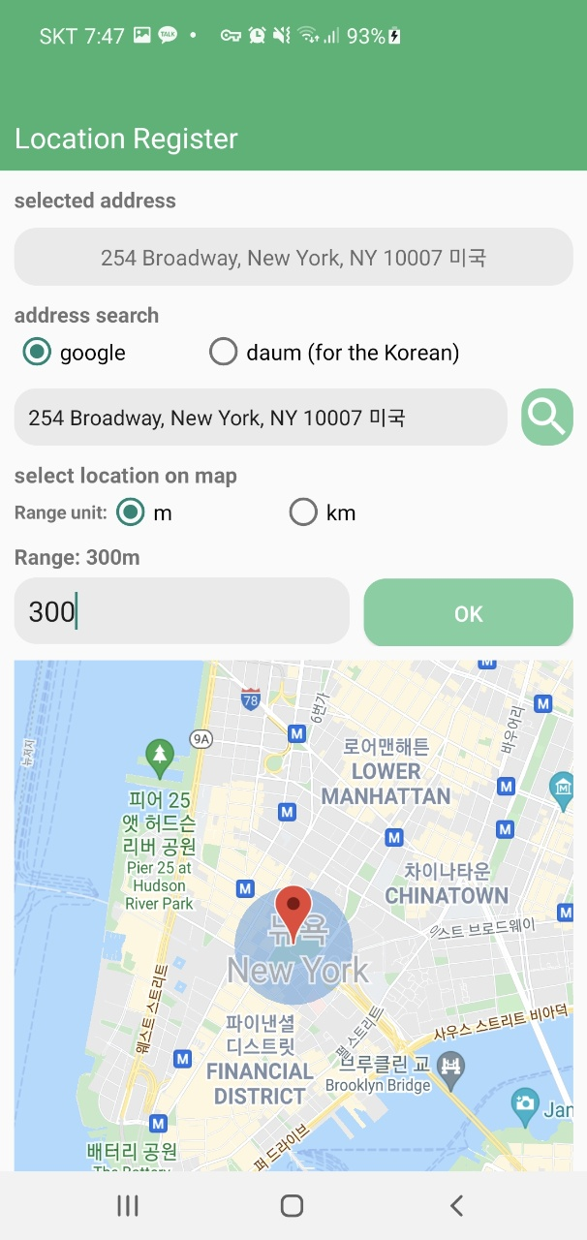
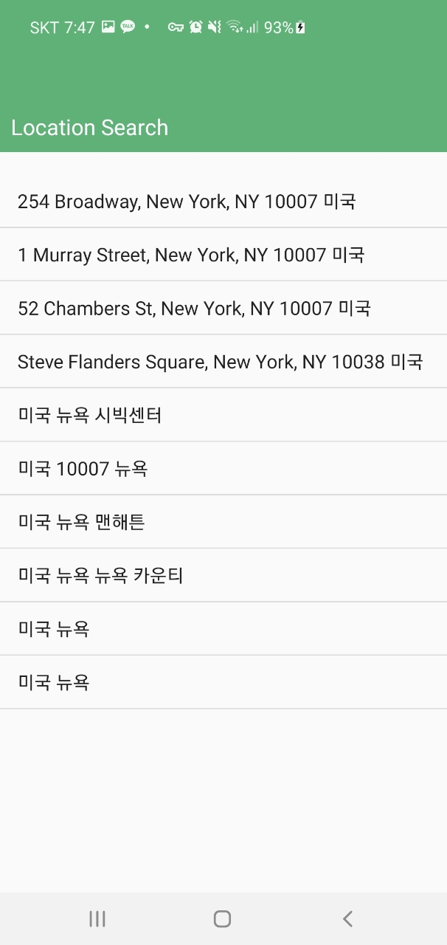
Flow of Application Development
Smartphone Application (SignIn-location register)
Location Register page has been created
User can set the patient's basic location and safety range
If user search address with google geocoder, user can see the list of addresses as shown on the right screen
After setting this page, signin is completed
Notes:
Last week: Basic outline of application has been created

Slide 10
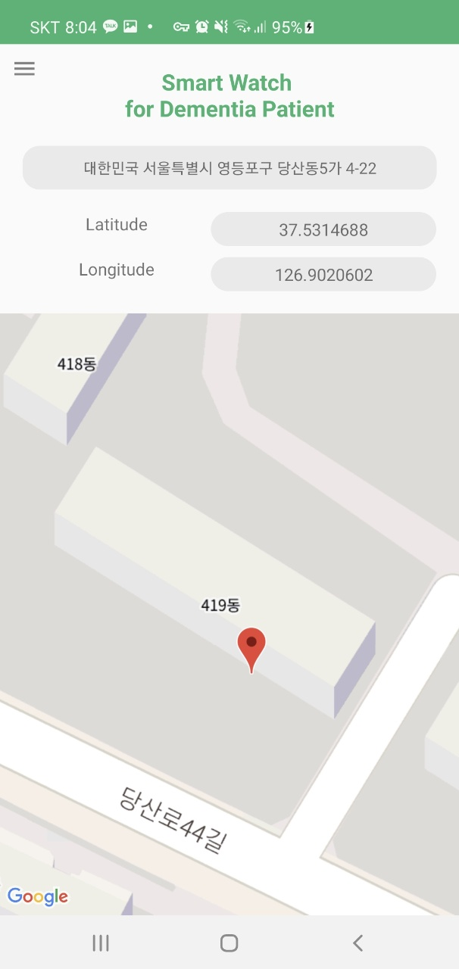
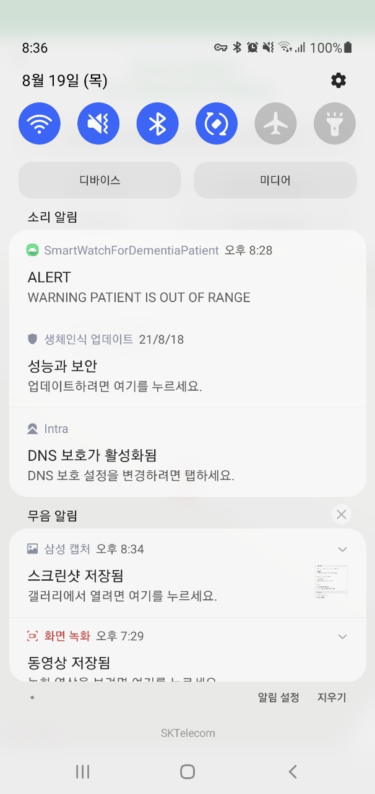
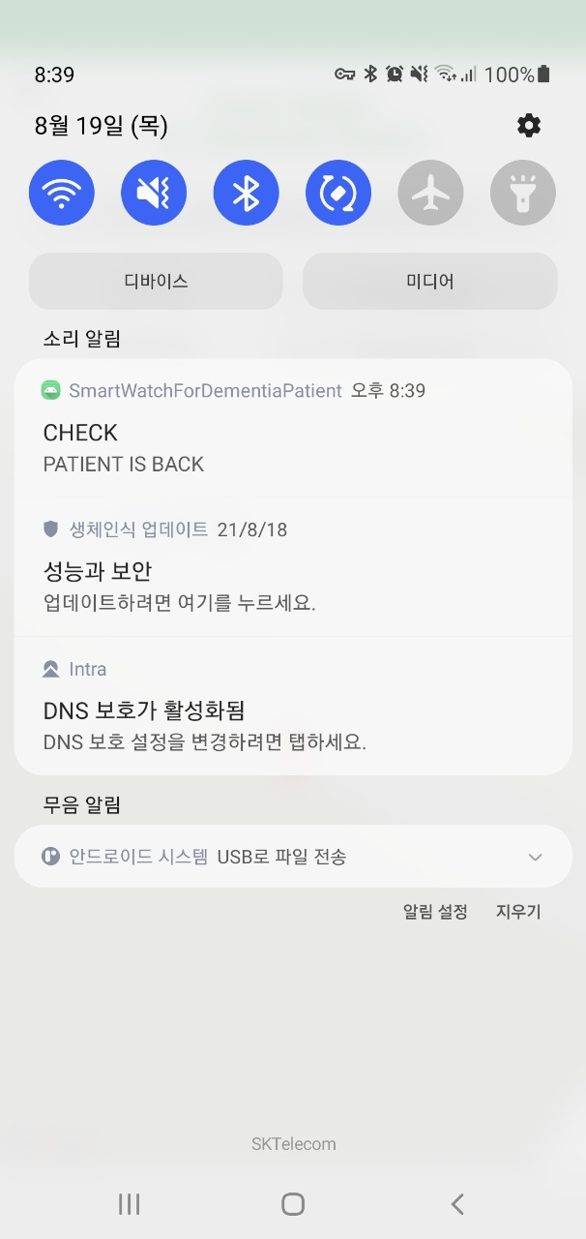
Flow of Application Development
Smartphone Application(Main)
Every 13 seconds, app gets the patient's location from server
Main page shows the patient's location continuously with marker, address, latitude and longitude
If the patient is out of safety, a push alarm is sent to guardian and a message is sent to patient
This activity also works in background, so even if the app is closed, app push alarm is sent to guardian that the patient is out of safety zone
If the patient was out of safety range and came back, then push alarm is sent to guardian that patient came back
Notes:
Last week: Basic outline of application has been created

Slide 11
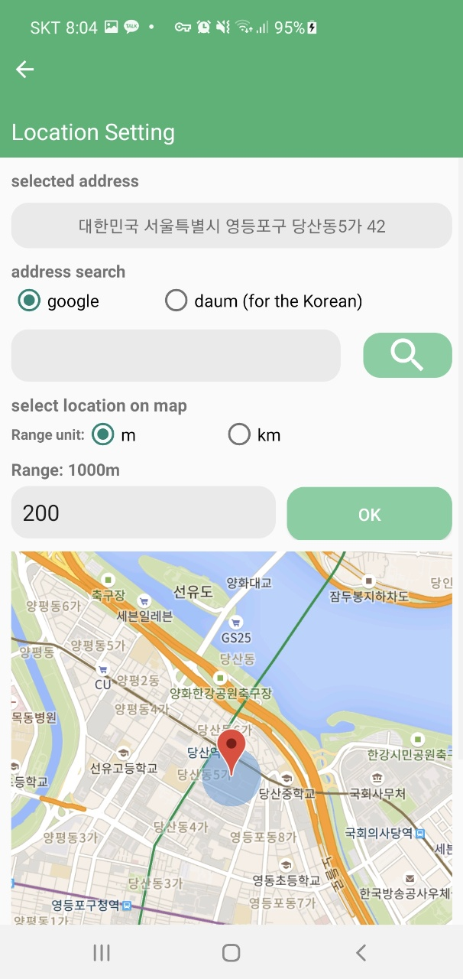
Flow of Application Development
Smartphone Application(location setting)
Location Setting Page has been created
This page has almost the same function as the location register page.
Guardian can set a safety range
Notes:
Last week: Basic outline of application has been created

Slide 12
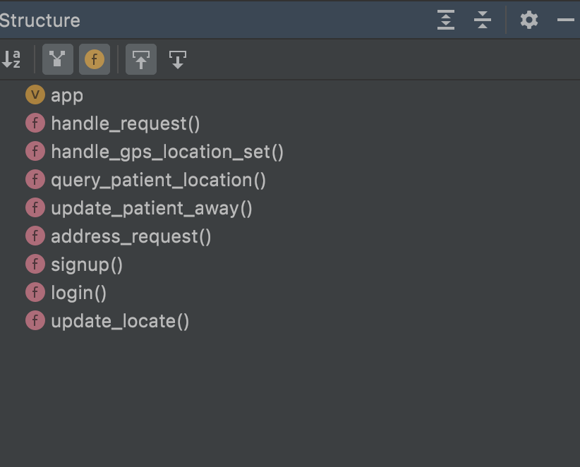
Server implementation
About server
OS system is Ubuntu on Amazon AWS EC2
Running server with Flask
Using MySQL for DB
Smart Watch uses API for getting patient’s current location
Smart Phone uses API for registering patient information, receiving patient’s current location, and receiving login user information.
Notes:
For the server:
Databases created to store data from smart phone application. It’s about user information to make login.
To save data(longitude and latitude) from smart watch, SQL queries was handled by ( ).

Slide 13
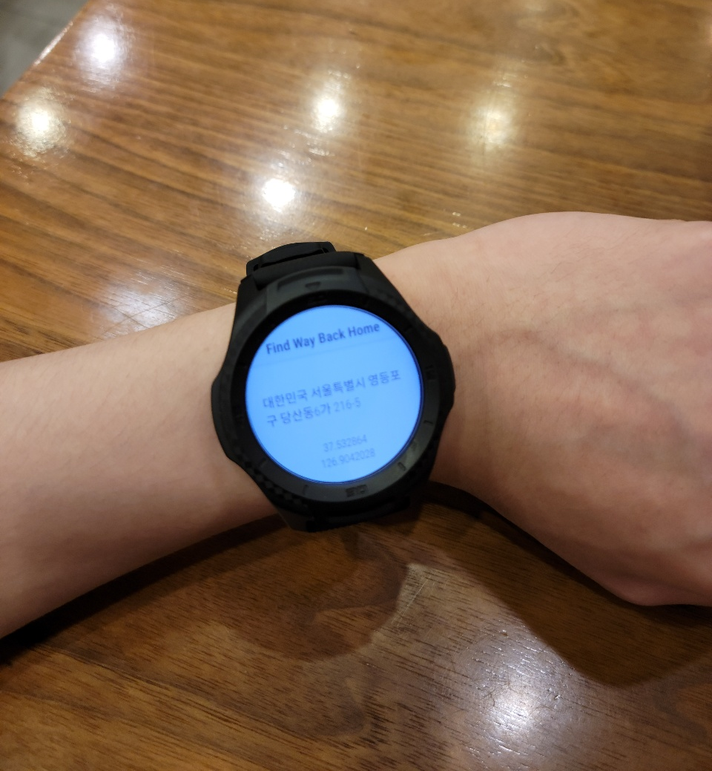
Smart watch
Smartwatch Application
Connect to the AWS-EC2 server
Put latitude and longitude into watch_data database
If patient gets out of boundary, app starts google maps navigation
Due to the limitation of the watch, navigation is started on the phone
Notes:
For the smartwatch
We were able to connect to the AWS-EC2 server
and input latitude and longitude data into “watch_data” database

Slide 14
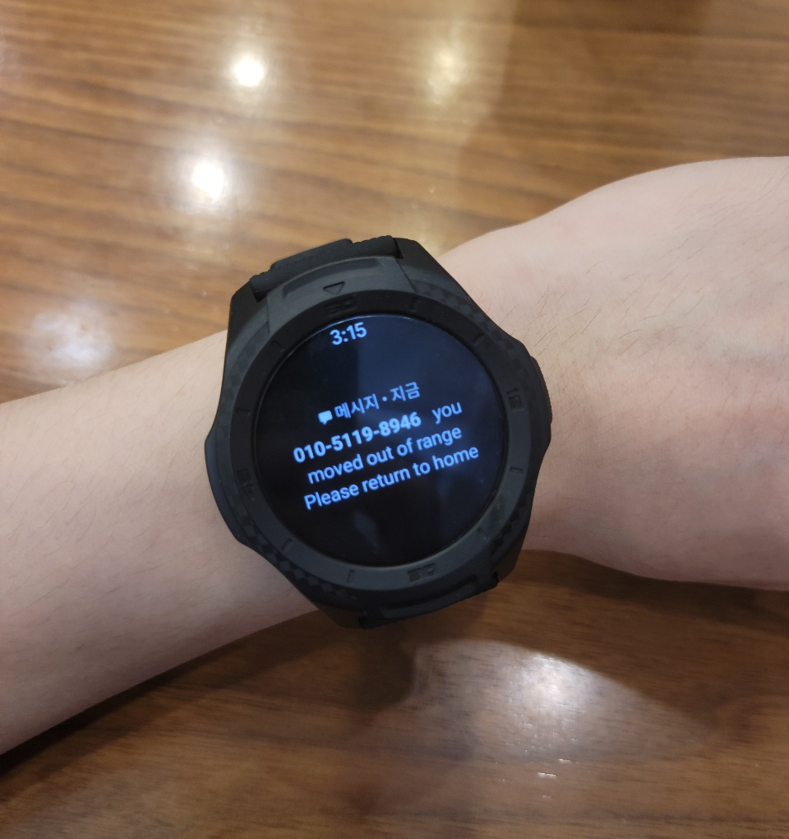
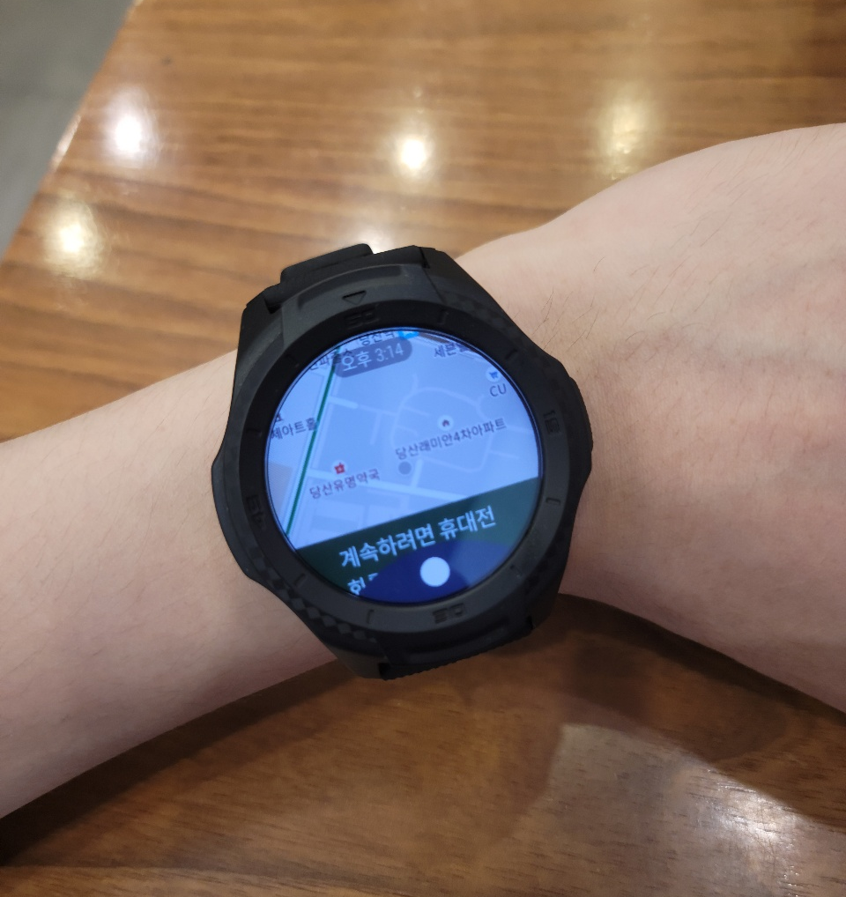
Smart watch
Smartwatch Application
Notes:
For the smartwatch
We were able to connect to the AWS-EC2 server
and input latitude and longitude data into “watch_data” database

Slide 15
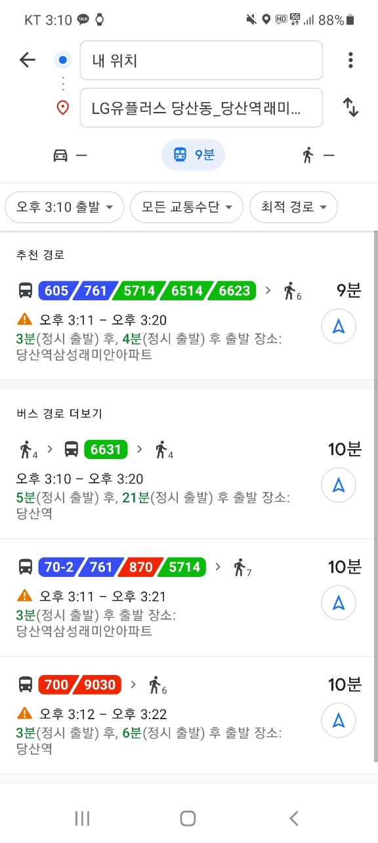
Smart watch
Navigation
In Smartphone →
Notes:
For the smartwatch
We were able to connect to the AWS-EC2 server
and input latitude and longitude data into “watch_data” database

Slide 16
Limitations / Improvements
Limitations
Improvements
Smart watch sends location data only when it is connected to wi-fi
The server might not work if there is too much traffic
Due to the watch’s limitation, watch cannot run navigation on its own. Smartphone is needed
We can use cellular model to be connected to server at all time
Using distributing method or traffic handling algorithm in server can allow multiple users to connect
We can implement some other features that we planned, such as finding nearby stations or determining patient’s means of transportation

Slide 17
Expected effects
Guardians can monitor dementia patients more easily
Guardians can find out if patient gets out of the zone
Patient can know if they got far from home
Patient can find their way back home using navigation
It is expected to reduce dementia patient’s wandering case

Slide 18
Thank you!

